Slide 1


Getting to know AWS Serverless with CDK, Java and Python
#DeveloperCareerDay2023

Slide 2
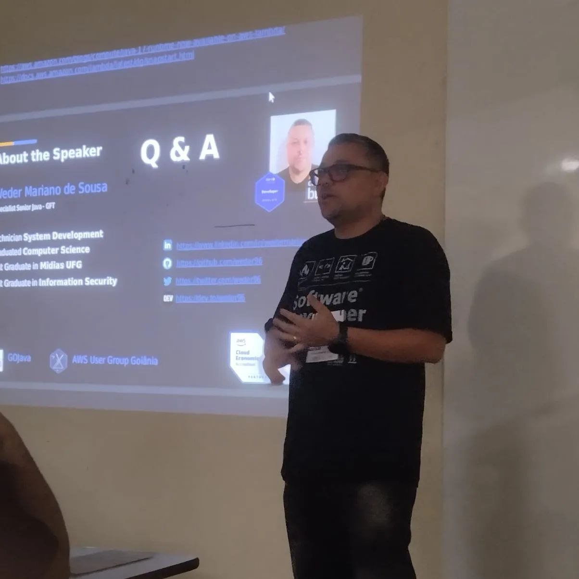

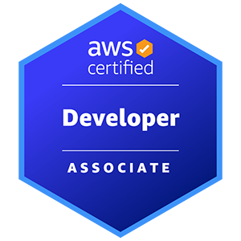
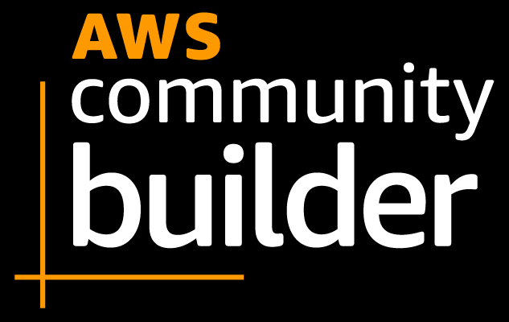
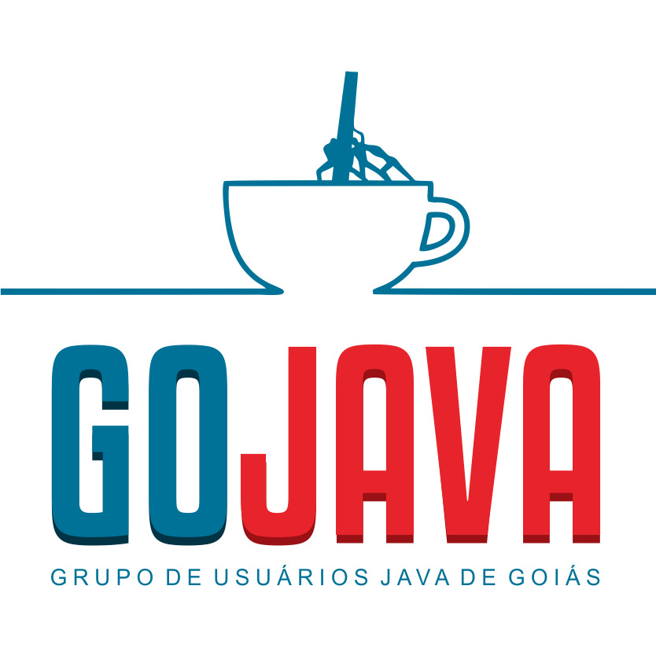
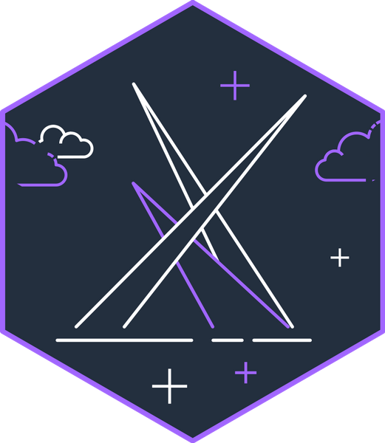
Me
Weder Mariano de Sousa
Specialist Senior Java - GFT
GOJava
AWS User Group Goiânia
Notes:
I work in the area of ​​computing since the year 2000.
I am currently a graduate in Computer Science, I have two specializations in Information Security (UniLeya) and the other in Intermediate Media (UFG). Prior to my graduation, I graduated from Cepa (Centro de Estudos Profissionalizantes de Anápolis) Developing Systems and attending FreeCodeCamp to evolve knowledge.
I worked in this time with several technologies among them,
Java
Spring Framework (dependency injection, Spring Data, Spring Security, Spring boot)
WebService (Rest / Soap)
Hibernate
HTML 5
Javascript, NodeJs
CSS, CSS3
Bootstrap
JSP
JSF (Primefaces)
AngularJS, React, React Native and VueJS
Database (Oracle, SqlServer, Postgres, MySQL and DB2)
Non-Relational Database (MongoDb, Neo4J)
Junit
Selenium
I am a computer teacher and Free Software enthusiast.
I helped coordinate FLISOL 2013,2014,2015 and 2016 in Anápolis-Goiás. Participate actively in the Free Software movement in Goiás, a member of the Anapolivre community, I am currently a Developer Analyst at Grupo GFT, where I work with Java and Angular projects, where I have been working since 2018.
I helped coordinate FLISOL 2013,2014
I helped coordinate JoinCommunity 2022, 2023
Grupo GFT
Java, Spring Boot, JPA, RestTemplate, WebClient, Reactive Programming, Functional Programming, Rest Assured, Mockito, Unit Testing, Cumcuber, Kafka, RabbitMQ, ActiveMQ, Azure Services, AWS Services

Slide 3

Agenda
Question Artificial intelligence
Use Case
Requirement and Tools
Introduction About Serverless
Architecture Serverless
AWS CDK For Java and Python
Next Steps
Notes:
Thanks for your time
let's go

Slide 4



Question Artificial intelligence
Create a study routine focused on learning Serverless AWS?
Notes:
I wanted to ask a question to Chat GPT (OpenAI) and Bard (Google), and upon receiving the answer, I thought, if I follow these steps that were suggested to me I could understand better about AWS Serverless.
Yes, this presentation in tutorial mode was born from this question.

Slide 5

ChatGPT
Ongoing
Join AWS forums and communities.
Follow AWS blogs and attend webinars.
Keep experimenting with new AWS services and features.
Stay updated with AWS documentation and best practices.
Week 1-2: Fundamentals and AWS Basics
Week 3-4: AWS Lambda
Week 5: AWS API Gateway
Week 6: AWS Step Functions
Week 7-8: Serverless Application Development
Week 9-10: Advanced Topics and Best Practices
Remember to adapt this study routine to your pace and
background knowledge.
Regular practice and hands-on experience are key to
becoming proficient in Serverless AWS.
Week 11-12: Real-world Projects and Certifications
Notes:
Both chatGPT and bard answered something similar, some small differences, but the same model
divided the content to be learned into weeks and at the end a message that leads the user to have something like discipline, talk to people with more knowledge on the subject and try, try and try

Slide 6

Bard
Find a study group. Work with other people
can help you learn and solve problems.
Don't be afraid to ask for help. If you get stuck on a concept,
Don't be afraid to seek help from your instructor, a friend or
of an online discussion group.
Week 1-2: Introduction to Serverless AWS
Week 3-4: AWS Cognito, AWS CloudWatch AWS CloudFormation
Week 5-6: Advances in Serverless AWS Serverless AWS Use Cases Serverless Projects
Personal Projects: Building Serverless AWS Applications Resources
Self-study: Reading documentation
AWS Documentation AWS Tutorials
This routine can be adapted according to needs and
student goals.
For example, students with experience developing
software can advance content more quickly.
Students with less experience can dedicate more time to
study of basic concepts.
Set realistic goals. Don't try to learn everything at once.
Start with the basics and progress gradually.
Create a schedule and stick to it. Having a plan will help you
keep motivated and on tr

Slide 7

Use Case
CRUD - Register Items
using AWS Serverless
Don't worry
about infrastructure
Notes:
When I think about the question about creating a regular, then I thought about creating something,
I started studying, step by step, AWS serverless technologies, one after another,
I got to know AWS CDK,
I come from a world where we only code, there were professionals with the knowledge about DevOps (Culture), however, we are currently the center of all tasks, from requirements analysis, such as unit testing and also in application observability issues, our activities have increased proportionally to the challenges of a new world of development using cloud computing
In this use case, we will work on creating an application that can save, change, search and delete an item, such as an item register, widely used in e-commerce, such as:
Alibaba (China) US$ 1,249 tri
Amazon (United States) US$602 billion
JD.com (China) US$505 billion
Pinduoduo (China) US$383 billion
eBay (United States) US$85 billion
Walmart (United States) US$ 73.2 billion
Shopee (Singapore) US$62.6 billion
Rakuten (China) US$ 32.8 billion
Mercado Libre (Argentina) US$ 28.4 billion
Vipshop (China) US$ 26 billion

Slide 8
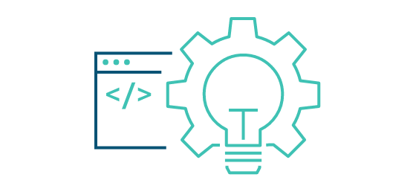

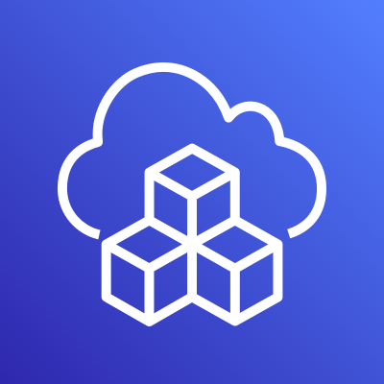

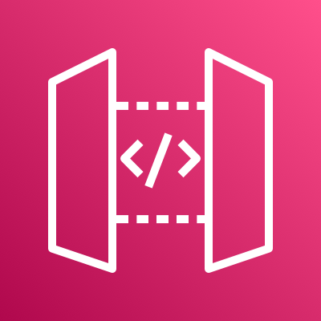


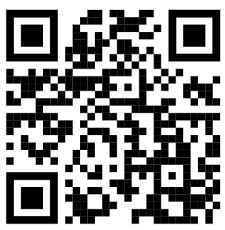
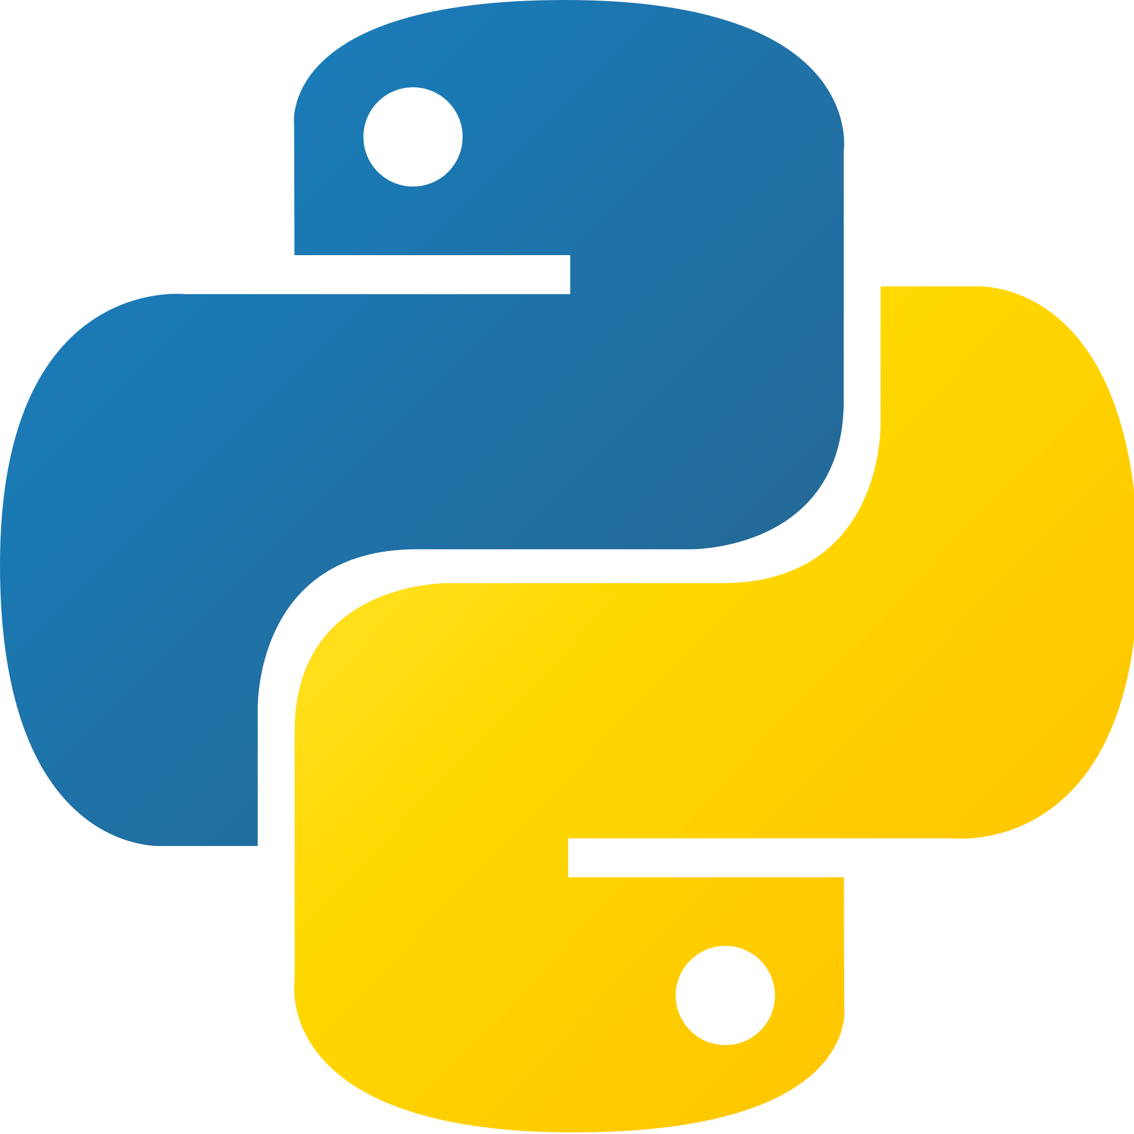




Use Case AWS CDK - CRUD
AWS Cloud
create
sdk(Boto3)
Users
POST
API Gateway
EndPoint
Lambda
function
Amazon
API Gateway
update
sdk(Boto3)
PATCH
API Gateway
EndPoint
Lambda
function
get All
sdk(Boto3)
GET
API Gateway
EndPoint
Lambda
function
DynamoDB
Table
(orders)
get By Id
sdk(Boto3)
GET
API Gateway
EndPoint
Lambda
function
delete
sdk(Boto3)
Stack
DELETE
API Gateway
EndPoint
Lambda
function
AWS CloudFormation
Amazon CloudWatch
https://github.com/weder96/poc-cdk-java
Notes:
In this use case, we focus on creating API using the HTTP protocol, for this service we will use API Gateway in Rest API mode
We will create 5 endpoints (Create, Update, getOne, getAll, Delete), using methods (Post, Patch, Get, Get, Delete) respectively.
each endpoint is connected to a lambda function, using the Python programming language in its version 3.10 in its code
Lambda functions coded in Python will use Boto3, the AWS SDK for communication and manipulation of data or events between AWS services.
Something to clarify here at this point is the difference between CDK and SDK, CDK is used to create AWS services, but behind the same being used is the SDK to create all these services.
This is important because boto3 uses the SDK to communicate between services.
All services in this use case will be created using CDK in Java(11).
You can point the qrcode reader and see the repository on github (weder96), or follow the link below, where you will find all the codes that we will use in this use case

Slide 9

Requirement and Tools

Slide 10
Requirement and Tools
AWS Account and User
AWS CLI
Python 3.10
IDE for your programming language = Visual Studio Code
IDE for your programming language = Intellij IDE
Postman
Notes:
1. It is necessary to create an account on AWS, when creating it they will ask for a credit card number, but only for validation and additional usage charges, however when creating your account you will be starting your free tier, in our case all the services that we will use for create our use case, there is no additional cost.
2. CLI it is necessary to configure your accesskey and secretKey to use the command execution feature that creates services in AWS without the need for manual creation via the console, just use the console to validate that it was created as specified
3. This is optional, as it can be tested directly with lambda functions, but it's nice to have some knowledge of programming in Python
4. This is optional Visual Studio Code is a source code editor developed by Microsoft for Windows, Linux, and macOS. It includes support for debugging, built-in Git versioning, syntax highlighting, smart code completion, snippets, and code refactoring. release 2015
5. This is optional IntelliJ IDEA is an integrated development environment written in Java for developing computer software written in Java, Kotlin, Groovy, and other JVM-based languages. release 2001, you can use the community version
6. This is optional Postman is an API platform for developers. The company is locate in San Francisco and maintains an office in Bangalore, where it was founded. As of February 2023, Postman reports having more than 25 million registered users and 75,000 open APIs, which it says constitutes the world's largest public API hub.
We will use postman to make http calls on our created endpoint
Note: items listed as optional can be exchanged for others that have the same purpose

Slide 11
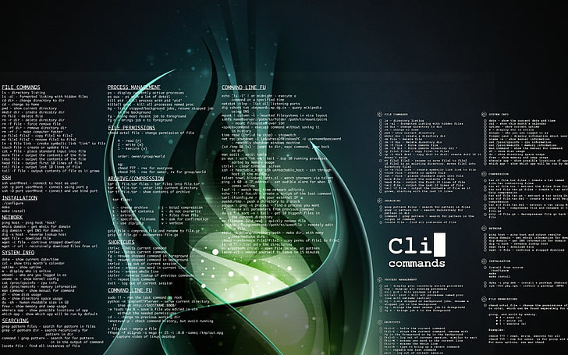

Install AWS Command Line Interface (AWS CLI) Linux

Slide 12
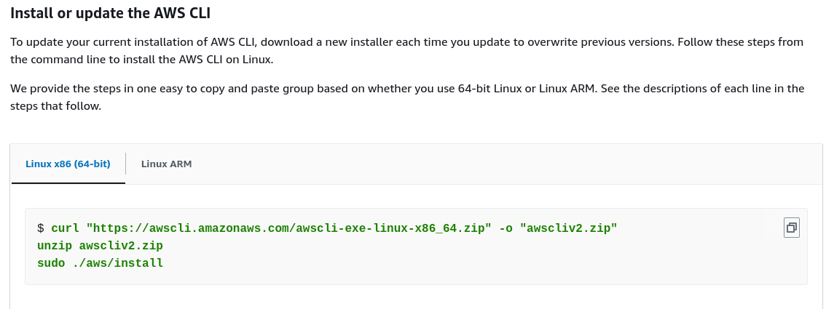
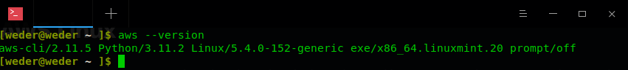
Install AWS Linux
You must be able to extract or "unzip" the downloaded package. if your operating system doesn't have the built-in unzip command, use an equivalent.
The AWS CLI uses glibc, groff, and less. These are included by default in most major distributions of Linux.
We support the AWS CLI on 64-bit versions of recent distributions of CentOS, Fedora, Ubuntu, Amazon Linux 1, Amazon Linux 2 and Linux ARM.
Because AWS doesn't maintain third-party repositories.
We can’t guarantee that they
contain the latest version of the AWS CLI.
https://docs.aws.amazon.com/cli/latest/userguide/getting-started-install.html
Notes:
You can install aws-cli on several distributions, however it is better to install directly from the AWS repository, because you cannot guarantee that the latest version when installed by third-party repositories
This example(slide presentation) we are installing aws-cli on a 64 bit (Linux Mint 21.2 "Victoria"), using curl command , then unzipping and running the installation command,

Slide 13

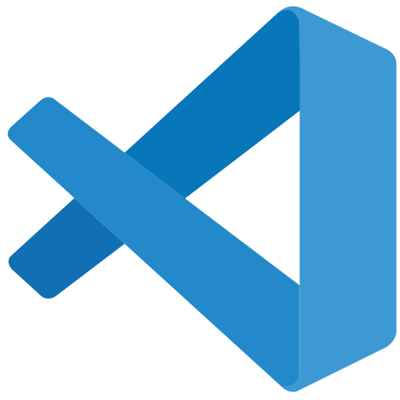

AWS IDE Toolkits

Slide 14
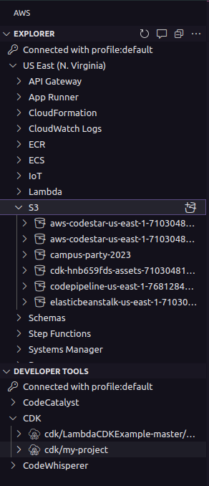
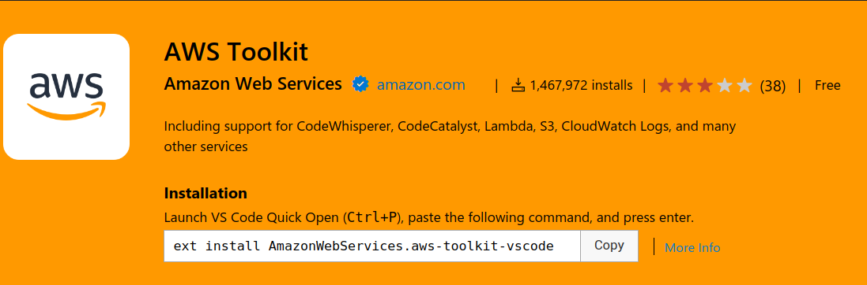
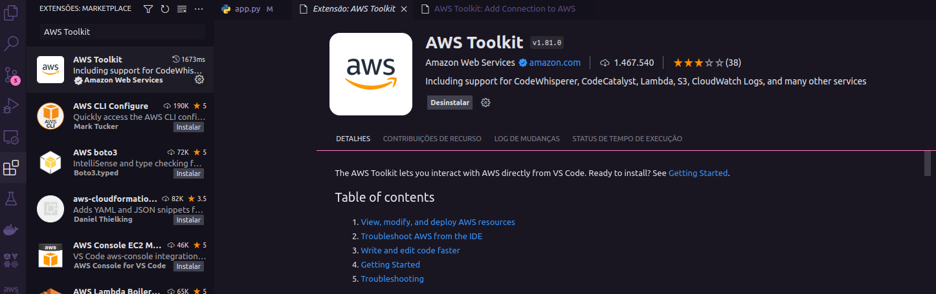
AWS Toolkit for Visual Studio Code
https://aws.amazon.com/serverless/?nc1=h_ls
https://marketplace.visualstudio.com/items?itemName=AmazonWebServices.aws-toolkit-vscode
Notes:
There is an AWS extension that can be installed in vscode, it shows you which services were created, being the same useful, helping in many cases

Slide 15
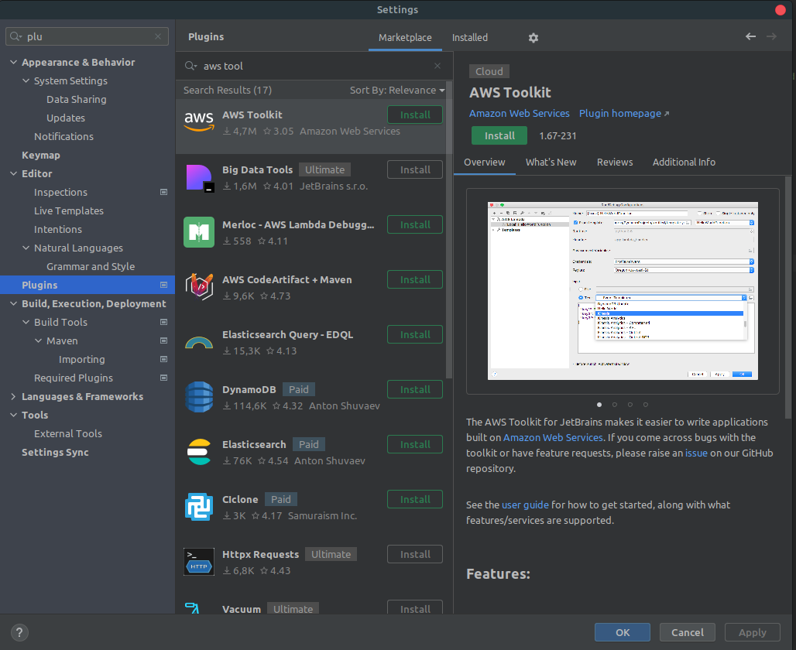
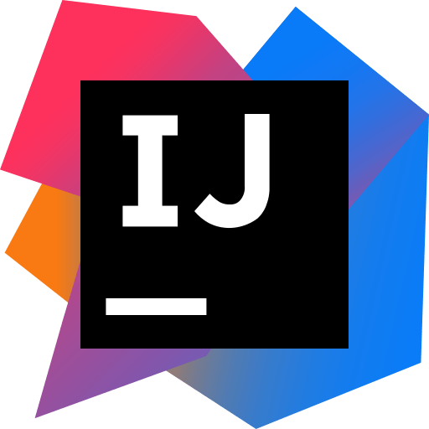
What is Toolkits IDE AWS ?

Slide 16
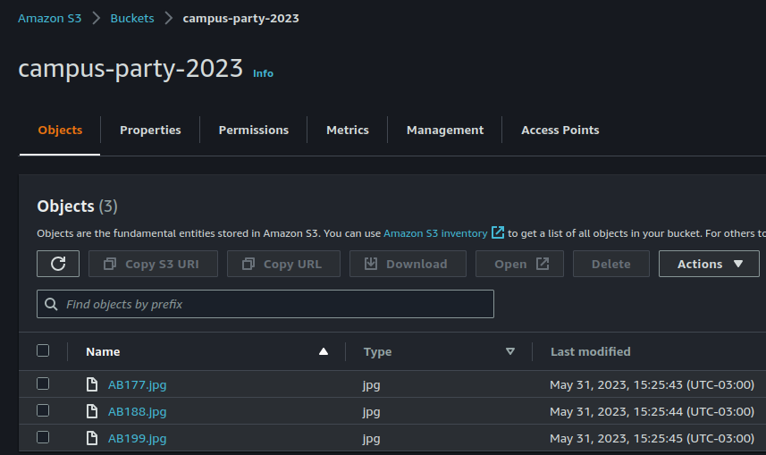
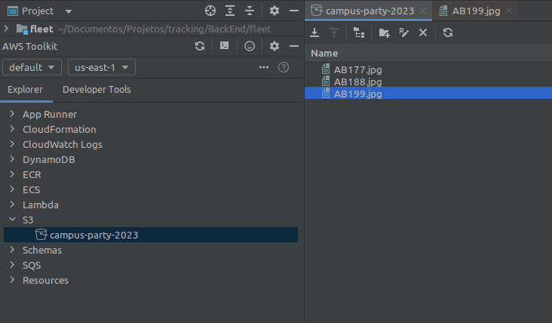
What is Toolkits IDE AWS ?

Slide 17

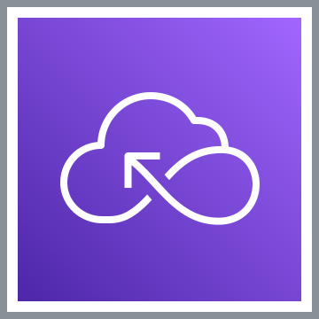
AWS Serverless

Slide 18
What is “Serverless” ?
It’s not about having servers or the lack of servers
https://da-public-assets.s3.amazonaws.com/serverlessland/pdf/SVS401-ri22.pdf

Slide 19
What is “Serverless” ?
Consider “serverless” as:
A mindset, an approach, a practice, a culture, a way of working Focus on business value, rather than the enabling technology
Benefits:
Faster time to market from prototype to production
Rapid, continuous experimentation and feedback
React and deliver business changes with a product mindset
Serverless = the best way to build and run modern applications
“Serverless” architecture is an operational model
Minimize taking on ongoing operational tasks, outsource system administration tasks
Every non-serverless component = ongoing ops responsibility
Optimize for long-term maintainability
Serverless does not mean "No Ops“!
Concentrate on the flow of data and events
https://da-public-assets.s3.amazonaws.com/serverlessland/pdf/SVS401-ri22.pdf

Slide 20
Events are the language of
serverless applications.
Dave Boyne
AWS Serverless Developer Advocate
https://da-public-assets.s3.amazonaws.com/serverlessland/pdf/SVS401-ri22.pdf

Slide 21
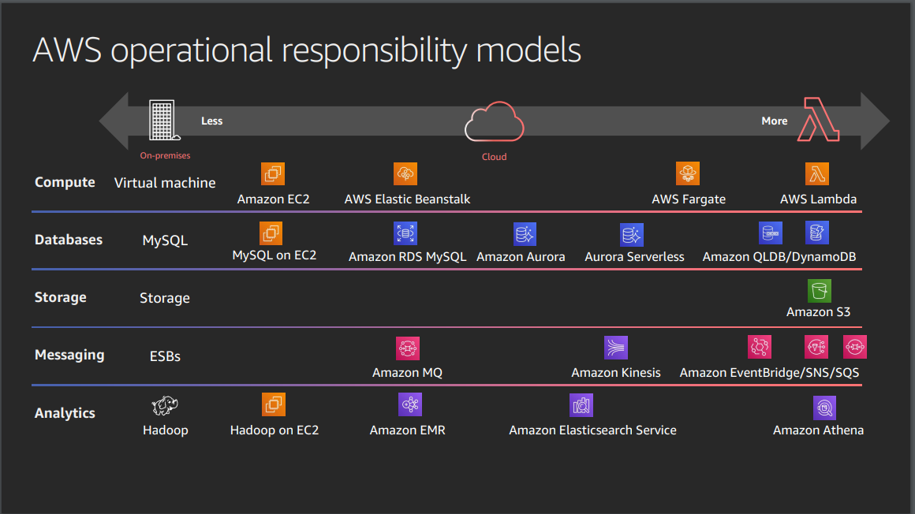
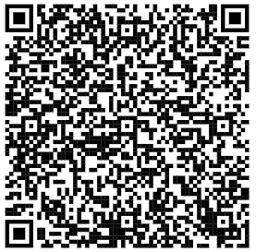
Serverless Explanained : AWS Operational Responsibility Model
Figure: 1 - AWS Operational Responsibility Model
https://d1.awsstatic.com/events/reinvent/2019/REPEAT_3_Serverless_architectural_patterns_and_best_practices_ARC307-R3.pdf
Notes:
our central objective, and to create an item management architecture, issues involving security are not part of the scope
In the slides shown we have two extremes, about AWS's responsibility and our responsibility, note that both sides always have responsibility for something at one extreme, more and at the other, less
The more responsibility AWS has, the more cost we will have, but this also helps us with relevant issues (backup, replicas, scaling), this configuration becomes faster, in addition to the main thing, not having to create a server and configure it, just configure main elements such as memory and cpu.

Slide 22
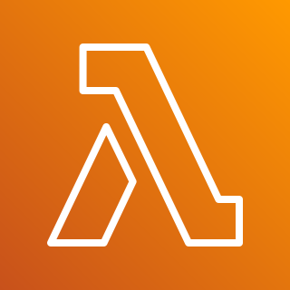
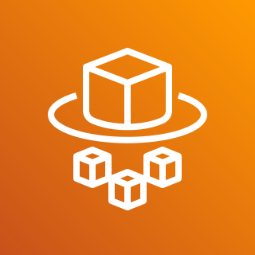

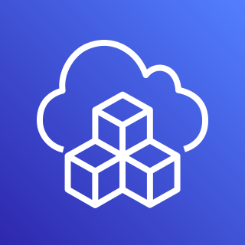


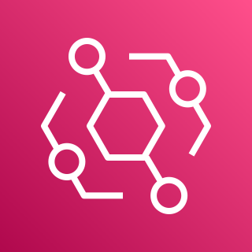
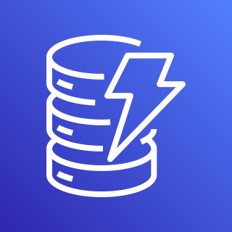
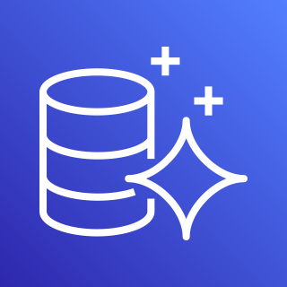
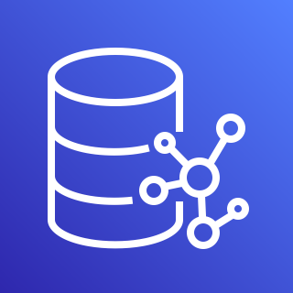
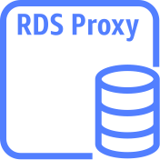
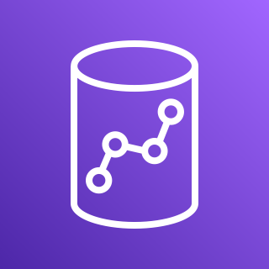

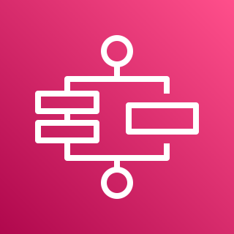


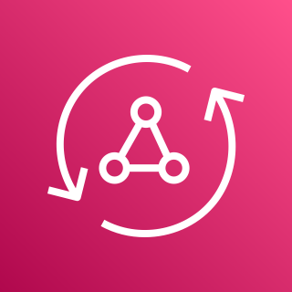

AWS Services Serverless
Application Integrations Services
Compute
Serverless Deployment
Frameworks
4
1
Authentication
and Authorization
3
2
AWS Lambda
AWS Fargate
Amazon Cognito
AWS CloudFormation
AWS CDK
Amazon
SNS
Amazon
SQS
Amazon
EventBridge
Data Persistence
5
Research and Analysis
6
Application Orchestration
7
DynamoDB
Aurora
Serverless
Neptune
Serverless
RDS
proxy instance
Amazon Redshift
OpenSearch
Service
AWS
Step Functions
Storing & Hosting
8
Streams
API and AppSync
9
10
Amazon S3
Amazon EFS
DynamoDB
Stream
Kinesis Data Streams
Amazon
API Gateway
AWS
AppSync
https://aws.amazon.com/serverless/?nc1=h_ls

Slide 23

AWS Services Serverless
Application Integrations Services
Compute
Serverless Deployment
Frameworks
4
1
Authentication
and Authorization
3
2
AWS Lambda
AWS Fargate
Amazon Cognito
AWS CloudFormation
AWS CDK
Amazon
SNS
Amazon
SQS
Amazon
EventBridge
Data Persistence
5
Research and Analysis
6
Application Orchestration
7
DynamoDB
Aurora
Serverless
Neptune
Serverless
RDS
proxy instance
Amazon Redshift
OpenSearch
Service
AWS
Step Functions
Storing & Hosting
8
Streams
API and AppSync
9
10
Amazon S3
Amazon EFS
DynamoDB
Stream
Kinesis Data Streams
Amazon
API Gateway
AWS
AppSync
https://aws.amazon.com/serverless/?nc1=h_ls
Notes:
we will focus on services with the check(color green) in the top corner

Slide 24
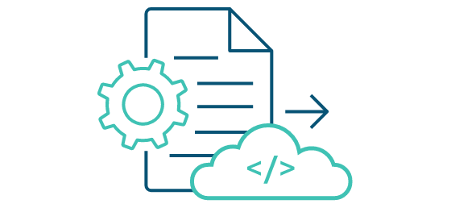


How to build, run and deploy?
When starting designing, and building serverless function, you might wonder how to deploy your function into the cloud. With AWS, there are some ways we can deploy, test and invoke your function:
Using the AWS Console Management: we can create lambda function, upload code, add triggers, and test your Lambda function manually. You might use this way when first.
AWS CLI: you also can use AWS Lambda CLI to create, deploy, invoke, manage, monitor your Lambda function. You can use existing commands to deploy and test your Lambda function automatically without manual process. But this isn’t good for production and large project.
AWS Serverless Application Model (AWS SAM) is an open-source framework for building serverless applications. It provides shorthand syntax to express functions, APIs, databases, and event source mappings.
AWS Cloud Development Kit (AWS CDK) is an open source software development framework to define your cloud application resources using familiar programming languages.
https://aws.amazon.com/serverless/getting-started/?nc=sn&loc=2&serverless.sort-by=item.additionalFields.createdDate&serverless.sort-order=desc

Slide 25
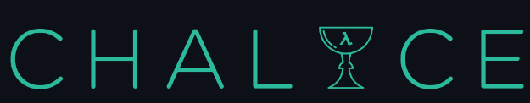

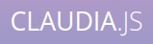
How to build, run and deploy?
Serverless Framework - The Serverless Framework consists of an open source CLI and a hosted dashboard. Together, they provide you with full serverless application lifecycle management.
Chalice is a framework for writing serverless apps in Python. It allows you to quickly create and deploy applications that use AWS Lambda.
Arc.codes provides everything you need to build massively scalable serverless apps with low code, clear and terse config, and zero ceremony.
Claudia.js makes it easy to deploy Node.js projects to AWS Lambda and API Gateway.
https://aws.amazon.com/serverless/getting-started/?nc=sn&loc=2&serverless.sort-by=item.additionalFields.createdDate&serverless.sort-order=desc

Slide 26
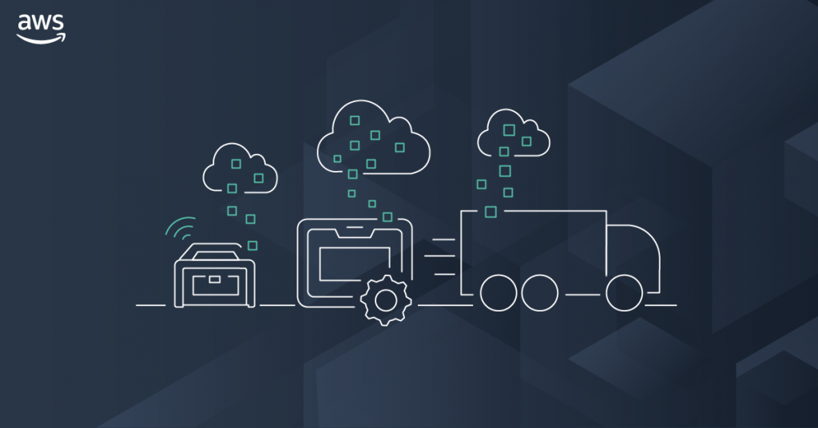
AWS Storage
Amazon S3
Amazon EFS
Notes:
AWS storage services
Object, file, and block storage
Amazon Simple Storage Service (S3)
Object storage with industry-leading scalability, availability, and security for you to store and retrieve any amount of data from anywhere.
Amazon Elastic File System (EFS)
A simple, serverless, elastic, set-and-forget file system for you to share file data without managing storage.
Amazon FSx
Fully managed, cost-effective file storage offering the capabilities and performance of popular commercial and open-source file systems.
Amazon Elastic Block Store (EBS)
Easy to use, high-performance block storage service for both throughput and transaction-intensive workloads at any scale.
Amazon File Cache
High-speed cache for datasets stored anywhere, accelerate cloud bursting workloads.
Data migration
AWS DataSync
Online data transfer service that optimizes network bandwidth and accelerates data movement between on-premises storage and AWS storage.
AWS Snow Family
Offline data transfer devices with built-in security and logistics features for simplified data migration.
Hybrid cloud storage and edge computing
AWS Storage Gateway
Hybrid cloud storage service that gives you on-premises access to virtually unlimited cloud storage.
AWS Snow Family
Edge compute, data collection, and data transfer services with security and end-to-end logistics for mobile and rugged deployments.
Managed file transfer
AWS Transfer Family
Simple and seamless file transfer to Amazon S3 and Amazon EFS using SFTP, FTPS, and FTP protocols.
Disaster recovery and backup
AWS Elastic Disaster Recovery
AWS Elastic Disaster Recovery (DRS)
Minimize downtime and data loss with fast, reliable recovery of on-premises and cloud-based applications using affordable storage, minimal compute, and point-in-time recovery.
AWS Backup
Fully managed, policy-based service to centrally manage and automate data protection, compliance, and governance for applications running on AWS.

Slide 27
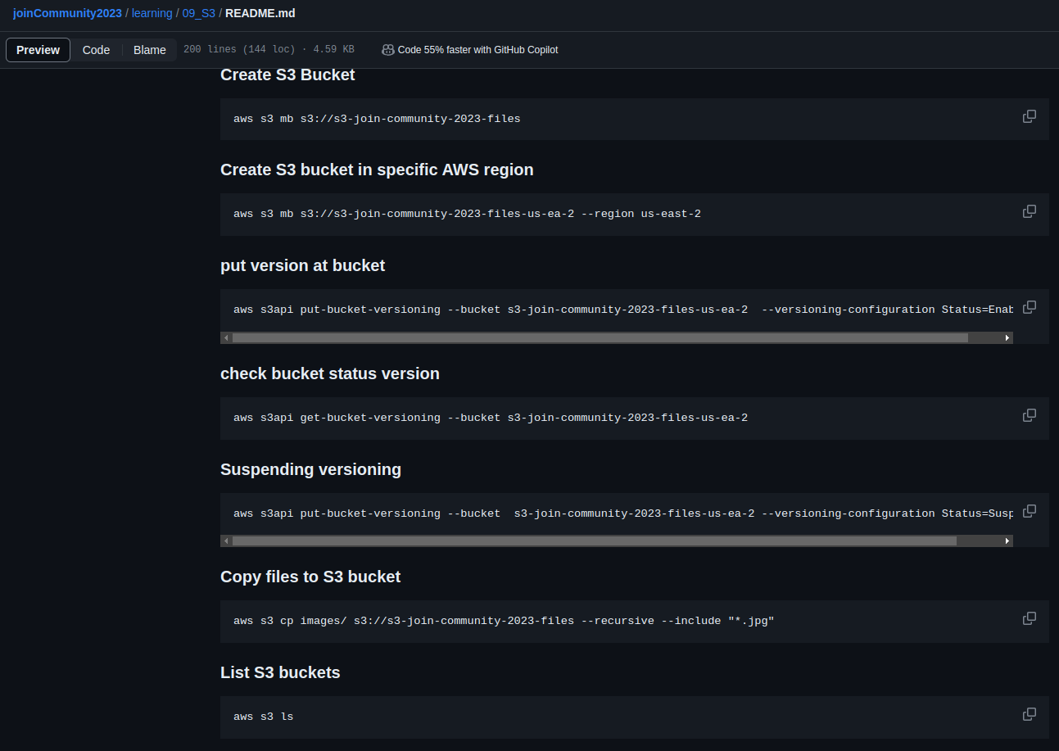
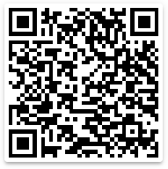
Amazon S3 CLI Commands
Amazon S3
Figure: 1 - describe using CLI Commands handling Objects in S3 service.
https://github.com/weder96/joinCommunity2023/blob/main/learning/09_S3/README.md
Notes:
this case, we can use CLI commands
The AWS Command Line Interface (CLI) is a unified tool to manage your AWS services from your terminal shell.
With just one tool to download and configure, you can control multiple AWS services from the command line and automate them through shell scripts.
The AWS CLI introduces a set of simple file commands for efficient file transfer to and from Amazon S3. The AWS CLI supports most of the functionality of the Amazon S3 web console, so you can use the AWS CLI instead of the Amazon S3 web console whenever possible.
This AWS CLI tutorial contains many AWS CLI S3 command execution examples you can use during your day-to-day AWS activities to manage Amazon S3 buckets and objects.
My github has a project teaching step by step how to use the main CLI commands to manipulate files, for example, copy, upload, download, delete and move, all using only CLI commands
You can follow the link or point your cell phone with a qrcode reader and validate how useful and practical it is to use the commands directly through the terminal, without using the AWS console
I will not go into details of the commands, as there are many and our focus is here and elsewhere.

Slide 28
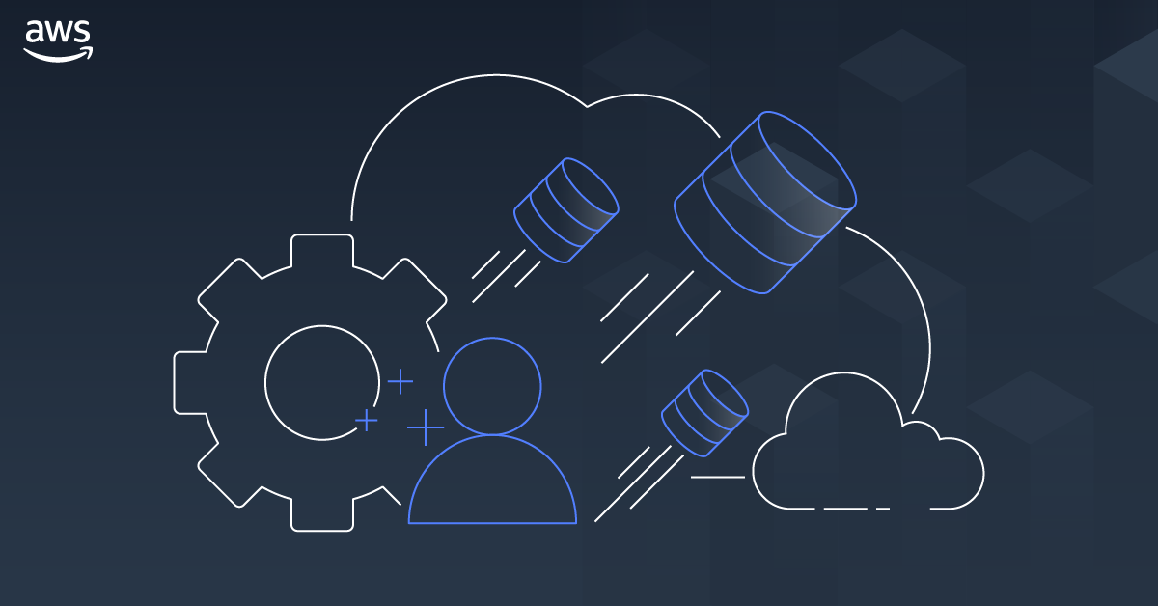
AWS Database
DynamoDB
Aurora
Neptune
Notes:
Database services
Database type |Examples | AWS service
Relational | Traditional applications, enterprise resource planning (ERP), customer relationship management (CRM), ecommerce | Amazon Aurora Amazon RDS Amazon Redshift
Key-value | High-traffic web applications, ecommerce systems, gaming applications | Amazon DynamoDB
In-memory Caching, session management, gaming leaderboards, geospatial applications | Amazon ElastiCache Amazon MemoryDB for Redis
Document | Content management, catalogs, user profiles | Amazon DocumentDB (with MongoDB compatibility)
Wide column | High-scale industrial apps for equipment maintenance, fleet management, and route optimization | Amazon Keyspaces
Graph | Fraud detection, social networking, recommendation engines | Amazon Neptune
Time series | Internet of Things (IoT) applications, DevOps, industrial telemetry | Amazon Timestream
Ledger | Systems of record, supply chain, registrations, banking transactions | Amazon Ledger Database Services (QLDB)
each database has its specific use and the choice depends on the business rules of your application

Slide 29
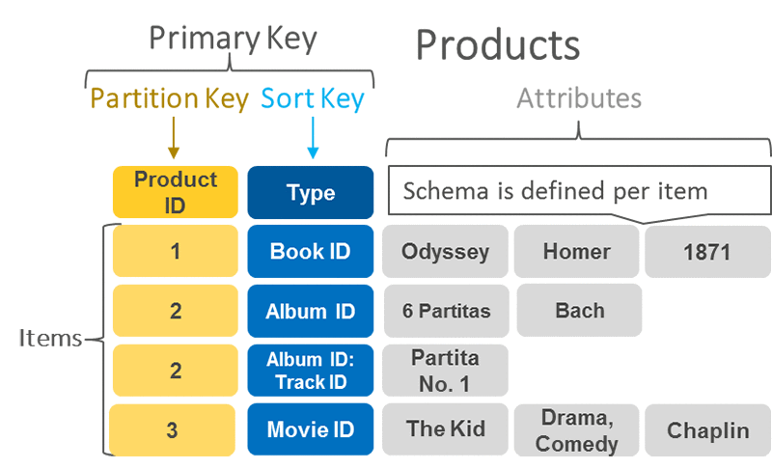
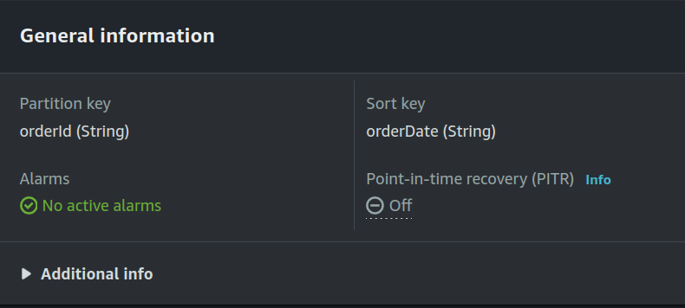
DynamoDB Primary Key, Partition Key and Sort Key
A primary key uniquely identifies each item in the table, so no
two items can have the same key.
DynamoDB supports two different kinds of primary keys:
Partition key
Partition key and sort key
Partition key
A simple primary key, composed of one attribute known as the
partition key.
Partition key and Sort Key
It is Referred to as a composite primary key, this type of key is
composed of two attributes. The first attribute is the partition
key, and the second attribute is the sort key.
DynamoDB uses the partition key value as input to an internal
hash function. A composite primary key gives you additional
flexibility when querying data
Figure: 1 - Partition Key and Sort Key (Primary key)
Figure: 2 - Details table (Partition Key, Sort Key)
https://aws.amazon.com/blogs/database/choosing-the-right-dynamodb-partition-key/
Notes:
a table in dynamodb is made up of two keys partition key and sortkey , and the union of the two creates a primary key, a manipulation function that only accepts changes if you specify both columns, for example data changes
describe figure 1
describe figure 2
let's see how we can perform an insertion into a table in the database using dynamodb

Slide 30
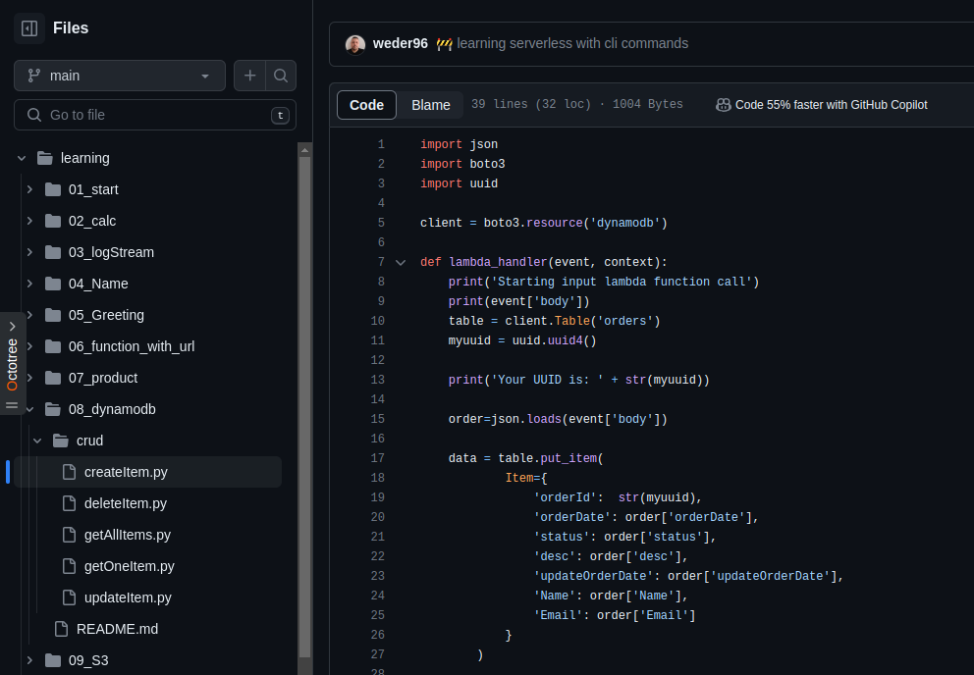
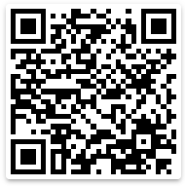
DynamoDB Python(Boto3)
DynamoDB
Figure: 1 - Function Lambda (using Python 3.10), CRUD DynamoDB
https://github.com/weder96/joinCommunity2023/tree/main/learning/08_dynamodb

Slide 31
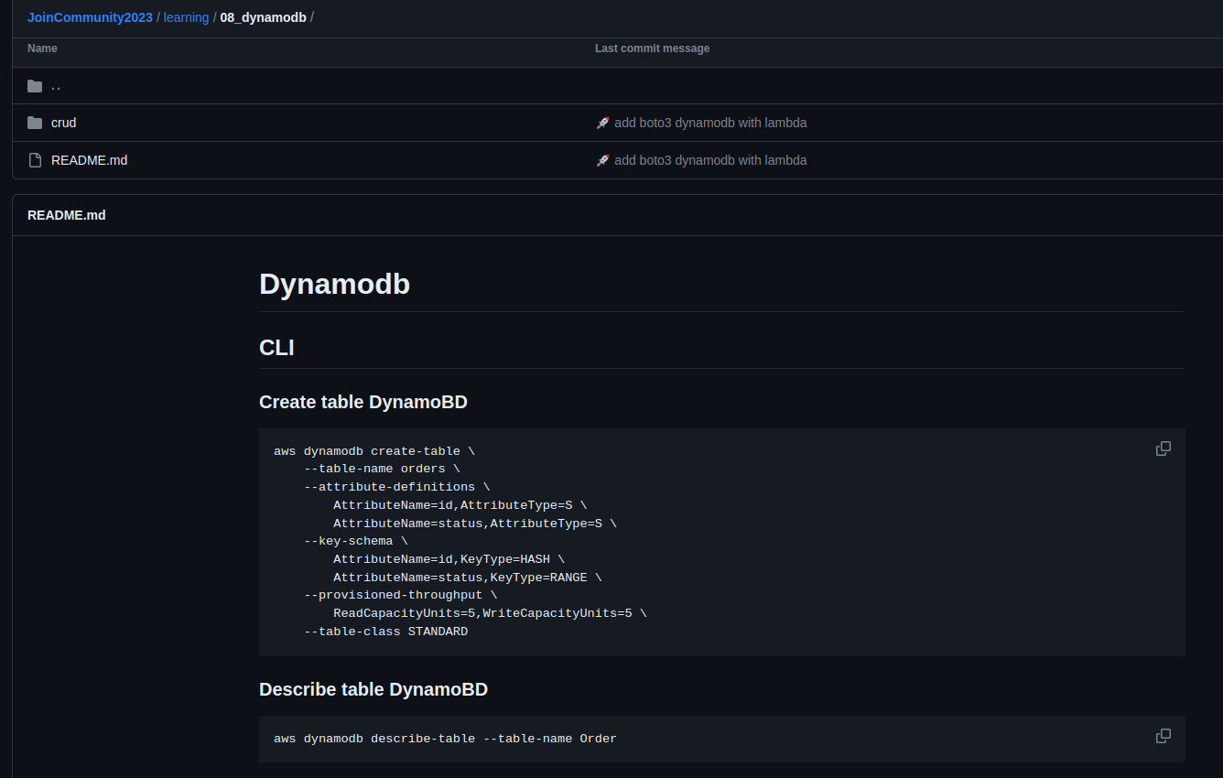
DynamoDB CLI Commands
DynamoDB
Figure: 1 - create table AWS CLI Commands
https://github.com/weder96/joinCommunity2023/tree/main/learning/08_dynamodb

Slide 32
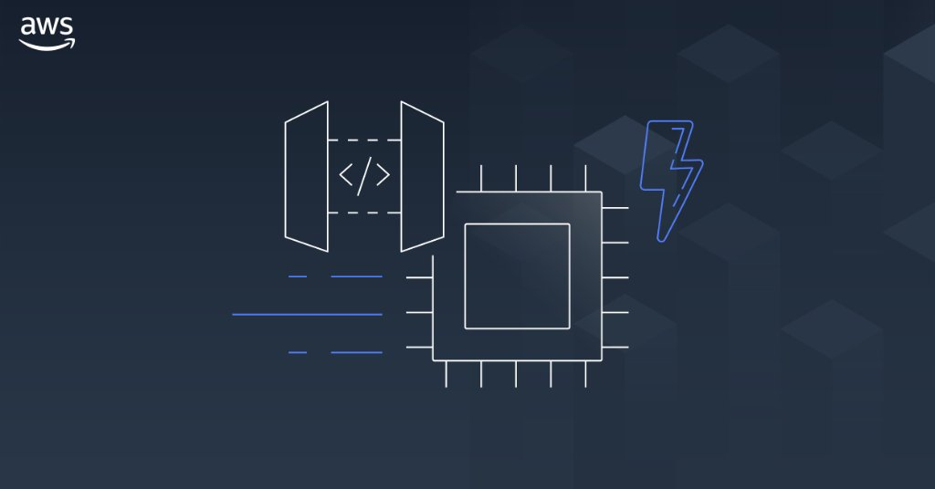
AWS API Gateway

Slide 33
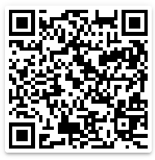
Amazon API Gateway Concepts
API Deployment – a point-in-time snapshot of your API Gateway API resources and methods. To be available for clients to use, the deployment must be associated with one or more API stages.
API endpoints – host names APIs in API Gateway, which are deployed to a specific region and of the format: rest-api-id.execute-api.region.amazonaws.com
API key – An alphanumeric string that API Gateway uses to identify an app developer who uses your API.
API stage – A logical reference to a lifecycle state of your API. API stages are identified by API ID and stage name.
Model – Data schema specifying the data structure of a request or response payload.
Private API – An API that is exposed through interface VPC endpoints and isolated from the public internet
Private integration – An API Gateway integration type for a client to access resources inside a customer’s VPC through a private API endpoint without exposing the resources to the public internet.
Proxy integration – You can set up a proxy integration as an HTTP proxy integration type or a Lambda proxy integration type.
Usage plan – Provides selected API clients with access to one or more deployed APIs. You can use a usage plan to configure throttling and quota limits, which are enforced on individual client API keys.
Amazon
API Gateway
https://github.com/weder96/aws-certification-learning/tree/main/module-5#section-10

Slide 34
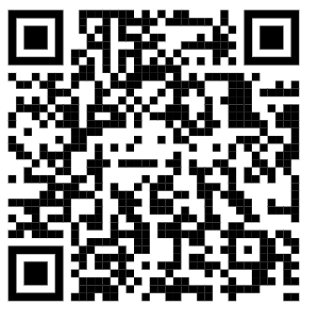

Amazon API Gateway CLI Commands
Amazon
API Gateway
Figure: 1 - create API Gateway AWS CLI Commands (Role, Lambda, Resources, Permissions, putMethodResponse)
https://github.com/weder96/joinCommunity2023/tree/main/learning/10_ApiGateway

Slide 35


AWS Application Integration
SNS
SQS
EVENTBRIDGE

Slide 36

Amazon SNS

Slide 37



Amazon SNS: Fully Managed Pub/Sub Messaging
Application
Integration
Application integration
The Fanout scenario is when a message published to an SNS topic is replicated and pushed to multiple endpoints.
Application alerts
Amazon SNS can send notifications to specified users via SMS and email.
User notifications
Amazon SNS can send push email messages and text messages to individuals or groups.
Mobile push notifications
Mobile push notifications enable you to send
messages directly to mobile apps.
Amazon SNS
Amazon SQS
AWS Lambda
EventType=
Poll-based
Queue
Lambda Function
Messages
1,2,3,....
Topic
EventType=
Poll-based
Queue
Lambda Function

Slide 38


Amazon SNS CLI Commands and (Python) Boto3
Amazon SNS
Figure: 1 - create SNS AWS CLI Commands (Lambda, topic , subscribe , permission)
https://github.com/weder96/joinCommunity2023/blob/main/learning/15_lambda_sns/README.md

Slide 39

Amazon SQS

Slide 40
What is Amazon SQS ?
Application
Integration
Amazon SQS stands for Simple Queue Service is fully managed message queues for microservices,
distributed systems, and serverless applications.
Enables you to decouple and scale microservices, distributed systems, and serverless applications.
Eliminates the complexity and overhead associated with managing and operating message-oriented
middleware.
Send, store, and receive messages between software components at any volume.
Two types of message queues.
Standard queues offer maximum throughput, best-effort ordering, and at-least-once delivery.
FIFO queues are designed to guarantee that messages are processed exactly once, in the exact order that they are sent.
Integrate and decouple distributed software systems and components.
Provides a generic web services API that you can access using any programming language that the AWS
SDK supports.
Amazon SQS
https://aws.amazon.com/sns/?nc1=h_ls

Slide 41
Amazon SQS What’s a queue?
Application
Integration
Send MEssages
Pool messages
Producer
consumer
Producer
consumer
Queue
consumer
Producer
consumer
Amazon SQS
https://aws.amazon.com/sns/?nc1=h_ls

Slide 42


Amazon SQS CLI Commands and (Python) Boto3
Application
Integration
Amazon SQS
Figure: 1 - create SQS AWS CLI Commands (create, poll , send messages , permission, purge)
https://github.com/weder96/joinCommunity2023/blob/main/learning/16_lambda_sqs/README.md

Slide 43

Amazon EventBridge

Slide 44

What is Amazon EventBridge ?
Serverless event bus service for AWS services
Build event-driven applications at scale using events generated from your apps
Use to connect your applications with data from a variety of sources, integrated SaaS applications
AWS services to targets such as AWS Lambda functions
Formerly called Amazon CloudWatch Events
https://serverlessland.com/patterns
https://da-public-assets.s3.amazonaws.com/serverlessland/pdf/2021+-+Serverlesspresso+exhibit+-+PDF.pdf

Slide 45

What are events?
An event is defined in JSON
"Detail" is application specific
Envelope attributes are provided by
Amazon EventBridge
Producers create events
Consumers choose which events to
Listen to by using rules
Figure: 1 - JSON event details is Custom(You define)
https://da-public-assets.s3.amazonaws.com/serverlessland/pdf/2021+-+Serverlesspresso+exhibit+-+PDF.pdf

Slide 46


Understanding EventBridge target
Does not know about
consumers decoupled
Bus need permissions
to talk to targewt(ex lambda)
Eventbus
rule
target
filter out events
Eventbus
rule
Also knoe as
consumer
Target Example
Lambda
What are target ?
Targets are consumer of you events
use rules to process events before reaching targets
Target Permissions
Your eventBridge bus need permissions
to send events to targets
Serverless Visuals: Small bite sized visuals about Amazon EventBridge David Boyne

Slide 47


Amazon EventBridge CLI Commands and (Python) Boto3
Amazon EventBridge
Figure: 1 - create EventBridge AWS CLI Commands (create, putTarget, putRule , permission, putEvents)
https://github.com/weder96/joinCommunity2023/blob/main/learning/19_eventbridge/README.md

Slide 48

AWS Application Orchestration
STEP FUNCTIONS

Slide 49

AWS Step Functions

Slide 50












State types
Task
A single unit of work
Choice
Adds branching logic
Parallel
Fork and join the data across tasks
Wait
Delay for a specified time
Fail
Stops an execution and marks it as a failure
Succeed
Stops an execution successfully
Pass
Passes its input to its output
Map
Loop and Foreach

Slide 51


Create a Serverless Workflow with AWS Step Functions and AWS Lambda
Figure: 1 - StepFunctions Studio(create, view, execute the state Machine )
https://aws.amazon.com/pt/tutorials/create-a-serverless-workflow-step-functions-lambda/

Slide 52


Amazon Step Functions CLI Commands and (Python) Boto3
Figure: 1 - StepFunctions CLI Commands(create, update, execute the state Machine) and create lambda
AWS Step Functions
https://github.com/weder96/joinCommunity2023/blob/main/learning/21_step_function/README.md

Slide 53

AWS Lambda Overview

Slide 54
AWS Lambda Overview
Serverless on AWS, Build and run applications without thinking about servers
The most popular serverless compute platform that is using millions of customer
Running billions of invocations all over the world
Compute service that runs code without thinking any servers or underlying services
Serverless function that you only responsible for your actual code.
https://aws.amazon.com/serverless/?nc1=h_ls
https://aws.amazon.com/blogs/compute/serverless-icymi-q2-2023/

Slide 55


AWS Lambda Invocation Types
Triggered lambda functions with different AWS Lambda Invocation Types
AWS Lambda has 3 Invocation Types;
Lambda Synchronous invocation
Lambda Asynchronous invocation
Lambda Event Source Mapping with polling invocation
https://aws.amazon.com/blogs/architecture/understanding-the-different-ways-to-invoke-lambda-functions/

Slide 56

Lambda Function Code
AWS Lambda runs instances of your function to process
events.
Invoke function directly using the Lambda API, or
configure an AWS service or resource to invoke your function.
Lambda function has code to process the events
that you pass into the function or that other AWS
services send to the function with event json object.
The event object contains all the information about
the event that triggered this Lambda.
The context object contains info about the runtime
our Lambda function
Return the function with the results

Slide 57



AWS Lambda Execution Role
Resource Based
Policy
Execute Role
Policy
AWS Lambda Permissions
Lambda Execution Role
Resource-based policy
Lambda Execution Role
IAM role that Lambda has permissions to assume when invoking
lambda function.
Create an execution role when creating a new lambda function, and
after that we can also modify the policies associated with the IAM role.
if you have additional targets from your lambda function
performing crud operations on DynamoDB table
sending notification to SNS
retrieve messages from queue or streams
Lambda function's execution role required permissions to
interact with those AWS services
Grant least privilege access to your Lambda execution role
Who can Invoke
Lambda ?
Who can interact
Lambda Invoke ?
AWS Lambda
Figure: 1 - Policy(JSON), set Permissions for execute lambda or
lambda invoke AWS Services
https://docs.aws.amazon.com/lambda/latest/dg/lambda-intro-execution-role.html

Slide 58
AWS Lambda Resource-based Policy
Lambda Resource-based policy
When any AWS service invokes Lambda function sync or async way. It lets you grant usage permission to other AWS accounts or organizations on a per-resource basis. Also use a resource-based policy to allow an AWS service to invoke your function on your behalf.
API Gateway that targets to Lambda function, we should add resource-based policy permission to invoke
lambda function from API gateway.
Amazon S3 upload event triggers to lambda function asyncrhously, so we should also add Resource-based policy into our Lambda function grants S3 invocation.
Resource Based
Policy
Execute Role
Policy
Amazon SNS
DynamoDB
Amazon
API Gateway
allow
sns.amazon.com
Lambda:
InvokeFunction
allow
Dynamodb: PutItem
logs: PutLogs
AWS Lambda
Amazon CloudWatch
Amazon S3
https://docs.aws.amazon.com/lambda/latest/dg/lambda-intro-execution-role.html

Slide 59

Architecture
Serverless
Notes:
we reached a different level

Slide 60
Amazon SNS with AWS Management Console
AWS Cloud
Command CLI
Create
User
topic
Topic
AWS Command Line Interface (AWS CLI)
Amazon Simple Notification Service (Amazon SNS)

Slide 61
Amazon SQS Queue Polling From AWS Lambda
AWS Cloud
Send /Messages
EventType =
Poll-based
User
Queue
Lambda
function
Amazon Simple Queue Service (Amazon SQS)
Event Filter
AWS Lambda

Slide 62

Microservices “REST”
AWS Cloud
service1.example.com
Amazon API Gateway
AWS Lambda
Amazon DynamoDB
microservice1
Client
AWS Cloud
service2.example.com
Amazon API Gateway
AWS Lambda
Amazon DynamoDB
microservice2

Slide 63



Build Serverless Chat App with a WebSocket API and Lambda
AWS Cloud
$connect route
$default route
WSS
send Message
route
Users
WebSocket
API
Amazon DynamoDB
{
"action": "sendMessage",
"message": "Hello from websocket !"
}
$disconnect
route
Lambda function
https://docs.aws.amazon.com/apigateway/latest/developerguide/websocket-api-chat-app.html

Slide 64

Secure your API Gateway with Amazon Cognito User Pools
AWS Cloud
Authenticate
token
Amazon Cognito
Verify token
Client
HTTP Call
with token
Amazon API
Gateway
AWS Lambda
Amazon DynamoDB

Slide 65




Using an Amazon S3 trigger to invoke a Lambda function
AWS Cloud
Amazon S3
AWS Lambda
Amazon CloudWatch
Permissions policy
Upload Object
in bucket
Bucket with
objects
Lambda function
Logs
Client
https://docs.aws.amazon.com/lambda/latest/dg/with-s3-example.html

Slide 66
AWS Lambda Destination to SQS - DLQ Case
AWS Cloud
Amazon S3
AWS Lambda
Amazon SQS
Permissions policy
Upload Object
in bucket
Bucket with
objects
Lambda function
Queue
Client
https://docs.aws.amazon.com/lambda/latest/dg/with-s3-example.html

Slide 67

Using an Amazon SNS to send message to Lambda function
AWS Cloud
Amazon SNS
AWS Lambda
Amazon CloudWatch
Permissions policy
CLI - Command
line Interface
Amazon SNS
Standart Topic
Lambda function
CloudWatch
Logs
Client
https://docs.aws.amazon.com/lambda/latest/dg/with-sns-example.html

Slide 68



Processing performance with Amazon Kinesis Data Streams and AWS Lambda
Front Ends
AWS Cloud
AWS Lambda functions
Client
Bucket S3
Mobile client
Insert Item
Amazon
DynamoDB Table
Amazon Kinesis Data Streams
Traditional server
Amazon Kinesis Data Streams
Users
https://aws.amazon.com/blogs/compute/increasing-real-time-stream-processing-performance-with-amazon-kinesis-data-streams-enhanced-fan-out-and-aws-lambda/

Slide 69
Command, Publish, Consume, Query (CPCQ)
AWS Cloud
User
AWS Lambda
(Command)
Amazon DynamoDB
(DB)
AWS Lambda
(publish)
microservice1
Amazon EventBridge
AWS Cloud
User
AWS Lambda
(query)
Amazon DynamoDB
(DB)
AWS Lambda
(Consumer)
microservice2

Slide 70

Event hub
Producer
Event Hub
Consumer
hub
stream
AWS Lambda
EventBridge
Amazon
Kinesis
AWS Lambda
Event Lake
Amazon S3
OpenSearch

Slide 71


Saga Pattern For Orchestrate Distributed Transaction (AWS StepFunctions)
AWS Cloud
Order Orchestrate
Client
Fail
/order
x-api-key
100 RPS
50 burst
Order
Table(Orders)
API Gateway
Microservice
Is Success
Fail
Remove Order
Inventory
Table(Inventory)
Microservice
Is Success
Fail
Revert Inventory
Payment
Table(Payment)
Microservice
Is Success
Fail
Revert Payment
Amazon CloudWatch
Success

Slide 72


Circuit Breaker and Many More by Jeremy Daly
AWS Cloud
Increment Failure Count
ElastiCache
open
Status?
close
Third Party API
User
Amazon API
Gateway
AWS Lambda
half open(fail)
half open(try)

Slide 73
Fan-Out Serverless Architectures Using SNS, SQS and Lambda
AWS Cloud
EventType=
Poll-based
Queue
Amazon SQS
Notification
Client
publish
Message
EventType=
Poll-based
x-api-key
100 RPS
50 burst
Queue
API Gateway
(Rest)
AWS Lambda
(Order Microservice)
Amazon SNS
Amazon SQS
Inventory
EventFilter
EventType=
Poll-based
Queue
Amazon DynamoDB
(Order Table)
Amazon SQS
Shipment
Amazon CloudWatch
Stack
AWS CloudFormation and CDK

Slide 74


Joot’s Serverless Architecture (Joot uses for image processing)
https://www.serverless.com/blog/serverless-architecture

Slide 75


AWS CDK for Java and Python
Shanghai, China, Nanpu Bridge
Notes:
I've been studying a lot about serverless over the last few years
However, what caught my attention the most was the possibility of creating the entire infrastructure via code in the language we are used to using in our projects.
And the aws cdk allows us to make all these configurations simply and directly using the interfaces and methods already established in the framework documentation.
In this use case we will use Java to create the infrastructure and Python for communication between resources (understand aws services)
let's go

Slide 76
What is “AWS CDK” ?
The AWS Cloud Development Kit (AWS CDK) is an open-source software development framework for defining cloud infrastructure as code(IAC) with modern programming languages and deploying it through AWS CloudFormation.
https://aws.amazon.com/cdk/faqs/
https://docs.aws.amazon.com/cdk/v2/guide/home.html
Notes:
It's easy to get set up and write your first CDK app. Short code examples are available throughout this Guide in the AWS CDK's supported programming languages: TypeScript, JavaScript, Python, Java, and C#. Longer examples are available in our GitHub repository.
The AWS CDK Toolkit is a command line tool for interacting with CDK apps. Developers can use the AWS CDK Toolkit to synthesize artifacts such as AWS CloudFormation templates and to deploy stacks to development AWS accounts. You can also diff against a deployed stack to understand the impact of a code change.
The AWS Construct Library offers constructs for each AWS service, many with "rich" APIs that provide high-level abstractions. The aim of the AWS Construct Library is to reduce the complexity and glue logic required when integrating various AWS services to achieve your goals on AWS.

Slide 77

CDK Lifecycle
1
2
3
Figure: 1 - How Lifecycle CDK Development
Notes:
CDK Lifecycle
1. CDK (with help of AWS CLI) compiles its 'App' (App is the executable program that contains Stacks and Constructs
2. CDK synthesizes the code to convert it into CloudFormation template. When you run cdk deploy the code we placed in lib/<code_name>.ts is parsed by the CDK Framework which then generates a CloudFormation template located in the cdk.out folder and finally deploys it to CloudFormation.
3. CloudFormation template gets deployed in AWS account and runs to create all the AWS components

Slide 78
CDK Code Structure
Apps
Stacks
Construct
Construct
Stack(DEV)
Construct
Construct
Construct
APP
Stack(UAT)
Construct
Construct
Stack(PRD)
Construct
Executable program
Used to render and deploy
cfn templates
Deployable unit
Knows about region and account
Construct
Representations of AWS resources
Can form a hierarchical tree structure
Notes:
CDK Code structure
Apps
Executable program
Used to render and deploy cfn templates
Stacks
Deployable unit
Knows about region and account
Constructs
Representations of AWS resources
Can form a hierarchical tree structure
They are files that include everything needed to deploy your app to a cloud environment.
The unit of deployment in the AWS CDK is called a stack. All AWS resources defined within the scope of a stack, either directly or indirectly, are provisioned as a single unit.
Because AWS CDK stacks are implemented through AWS CloudFormation stacks, they have the same limitations as in AWS CloudFormation.
Constructs are the basic building blocks of AWS CDK apps. A construct represents a "cloud component" and encapsulates everything AWS CloudFormation needs to create the component.
A construct can represent a single resource, such as an Amazon Simple Storage Service (Amazon S3) bucket, or it can represent a higher-level component consisting of multiple AWS resources. Examples of such components include a worker queue with its associated compute capacity, a cron job with monitoring resources and a dashboard, or even an entire app spanning multiple AWS accounts and regions.
More on Constructs
Level 1 Construct
CFN Resources are periodically generated from the AWS CloudFormation Resource Specification. They are named CfnXyz, where Xyz is name of the resource. For example, CfnBucket represents the AWS::S3::Bucket AWS CloudFormation resource. When you use Cfn resources, you must explicitly configure all resource properties, which requires a complete understanding of the details of the underlying AWS CloudFormation resource model.
Level 2 Construct
The next level of constructs, L2, also represent AWS resources, but with a higher-level, intent-based API. They provide similar functionality, but provide the defaults, boilerplate, and glue logic you'd be writing yourself with a CFN Resource construct. AWS constructs offer convenient defaults and reduce the need to know all the details about the AWS resources they represent, while providing convenience methods that make it simpler to work with the resource. For example, the s3.Bucket class represents an Amazon S3 bucket with additional properties and methods, such as bucket.addLifeCycleRule(), which adds a lifecycle rule to the bucket.

Slide 79



Demo CDK
Figure: 2 - BackEnd (Architecture Spring boot(Java))
Clone S3 AWS with CDK
Figure: 1 - FrontEnd (Architecture React)
https://github.com/weder96/aws-image-upload-wsousa
https://github.com/weder96/presentationCampusParty2022
Notes:
this demo was presented by me at campus party 2022 in goiania goias - Brazil, it demonstrates a frontEnd application that is a clone of the aws s3 console.
here React JS was used for FrontEnd development
Backend was created in java using the aws sdk to communicate with s3 and used all s3 functions via application type (listing, uploading, downloading, deleting) objects in a bucket, here in the backend java and the aws SDK were used (not to be confused with CDK)

Slide 80


Proof of Concepts AWS CDK
The purpose of this PoC is to understand how to use the CDK to generate the infra(JAVA) of a CRUD(Create, Read, Update, Delete) using , API Gateway, lambdas(Python) and DynamoDB, its advantages and limitations of traditional use with the creation of a Cloudformation(SAM) template.
Figure: 1 - Project CDK (Java 11), folder lambda(Python 3.10)
https://github.com/weder96/poc-cdk-java
Notes:
Figure 1 shows the CDK project in Java and also a folder with the .py files, which are read by the Java application to create the lambda functions in Python
On the bottom right side, the link to the github of this proof of concept or use case, or you can point a qrcode reader at it and you will be guided to the github of this project, it's worth checking out

Slide 81



Requirements for Installing AWS CDK
Before you can dive into the world of AWS CDK, you need to take care of a couple of prerequisites. First, ensure you have Node.js version 18.0.0 or later installed on your system.
Figure: 1 - Checking node version
Installing AWS CDK
Installing the AWS CDK is a breeze.
Run the following command in your terminal or command
prompt to install AWS CDK:
Figure: 2 - install aws-cdk
Verifying AWS CDK Installation
Figure: 3 - checking aws-cdk version install
https://hands-on.cloud/install-aws-cdk-guide/
Notes:
It is necessary to have already installed node 18+ on your machine(checking figure 1 cli command ). In my case I am using the version v.18.17.1
This is because you will run the installation of the aws cdk through the node's npm as seen in figure 2
checking install aws sdk with command cli cdk -- version
In my case I am using the version 2.93.0 , but but currently we are already on version 2.103.1, updates are at an accelerated rate

Slide 82


Initializing a CDK Project
,
To initialize a new CDK project, navigate to the desired directory in your terminal or command prompt and run the cdk init command with the appropriate template and programming language. For example, to create a Java-based CDK project, you would run the following command:
Figure: 1 - Create project CDK (Java)
Figure: 2 - Structure project CDK (Java)
https://hands-on.cloud/install-aws-cdk-guide/
Notes:
Initializing a CDK Project
To initialize a new CDK project, navigate to the desired directory in your terminal or command prompt and run the cdk init command with the appropriate template and programming language. For example, to create a Python-based CDK project, you would run the following command:
see in figure 1
This command generates the necessary files and directories for your CDK project, including the first_project folder containing your main stack, the app.py file serving as the entry point of your application, and a tests folder for any tests you may create.
Understanding project structure
see in figure 2
A typical AWS CDK project consists of several main components. The my_cdk folder that contains your main stack, the *.py files that are in the lambda folder will be created later, within the src folder, which is the entry point of our application.
Optionally, you can create the constructs folder to store any custom constructs that represent reusable components of your infrastructure.
By understanding the structure of your CDK project, you can organize your code and manage your resources more effectively.

Slide 83


Bootstrapping AWS CDK
Before deploying your AWS CDK app, you’ll need to bootstrap your stack. Bootstrapping involves creating dedicated Amazon S3 buckets and other containers required for deploying your app using AWS CloudFormation.
To bootstrap your stack, run the cdk bootstrap command in your terminal or command prompt. This command deploys a CDKToolkit CloudFormation stack into the specified environment, provisioning the necessary resources for your AWS CDK app.
cdk bootstrap
Figure: 1 - validated Account and Region to created Stack
Figure: 2 - Enviroment checking and found (Account and Region)

Slide 84

Building and Deploying Your AWS CDK App
Once your CDK project is set up, the next step is to build and deploy your AWS CDK app.
This process involves synthesizing CloudFormation templates in YAML format, saving them in the cdk.out folder as JSON, bootstrapping your stack, and deploying your app to your AWS account.
By following these steps, you can create and manage your AWS infrastructure using the power of AWS CDK and your preferred programming language.
cdk synth
Figure: 1 - Command aws-cdk generate AWS Cloudfromation(YAML)
To synthesize CloudFormation templates for your AWS CDK app, run the cdk synth command in your terminal or command prompt. This command generates YAML-formatted CloudFormation templates for each stack in your app, encompassing all the resources you’ve defined in your CDK code.
Figure: 2 - File AWS Cloudfromation(YAML) Genereted command aws-cdk

Slide 85

Deploying the App
You’re ready to deploy your AWS CDK app with your
synthesized CloudFormation templates and
bootstrapped stack. To do this.
Run the cdk deploy command in your terminal or
command prompt.
cdk deploy
Figure: 1 - Checking AWS Cloudformation Generated
This command deploys your CDK app to your
AWS account, creating and updating
the necessary AWS resources as
defined in your CloudFormation templates.
Once the deployment is complete, you can
monitor and manage your deployed resources
using the AWS Management Console
or AWS CLI.
Figure: 2 - Showing services and policies that will be created
Notes:
You’re ready to deploy your AWS CDK app with your synthesized CloudFormation templates and bootstrapped stack.
To do this, run the cdk deploy command in your terminal or command prompt
and the cool thing about it all
Managing Your AWS CDK Infrastructure
As your AWS CDK app grows and evolves, you’ll need to manage your infrastructure effectively. This includes updating existing resources, destroying resources when they’re no longer needed, and monitoring changes in your infrastructure.
By mastering these management tasks, you can ensure that your AWS CDK app remains efficient, secure, and cost-effective.
seen in figure 2
When typing the deploy command in the terminal, it will ask you to accept all creations or modifications, which the command will create within your AWS account, type y and press enter

Slide 86


Deploying the App
aws resources being created by the deploy command, using the template created in the synth command
Figure: 1 - Showing cdk creating all services aws
After creating it, it shows the time it was created and whether it managed to create all the necessary resources
Figure: 2 - Showing services created(ARN)
Notes:
With the deploy command accepted, you can follow all the processes that are being carried out, from created, updated, deleted, of each resource that was created in the constructors of your application that created the infrastructure.
In our case we created an API gateway and in the end it returns the created address to us, so we can make a call via HTTP with the correct method, type GET, POST and others..

Slide 87

Destroy the App
When you no longer need certain resources in your AWS CDK app, you can destroy them using the cdk destroy command. This command deletes the specified stack and all its associated resources unless they have been marked with a Deletion Policy to be retained.
cdk destroy
Figure: 1 - Command aws-cdk destroy
Figure: 2 - Showing aws-cdk destroy success (necessary confirmation(Y))
Notes:
Another cool moment, I want to delete all the resources created, but how to do it...
aws cdk creates a tag on all created resources and when we execute prompt the command "destroy", all created resources are destroyed
and a small comparison, the destroy time is much shorter than the deploy time
It is also necessary to confirm by typing y and pressing enter

Slide 88

Diff the App
When you have made changes to your infrastructure code by adding or removing certain resources in your AWS CDK application, you can use the cdk diff command. This command will show what has been modified and which resources will be created and will be listed for monitoring.
cdk diff
Figure: 1 - Command aws-cdk checking file diferences
Figure: 2 - Showing diff and list add or removes resources
Notes:
The diff command, in some cases we make changes and need to deploy these changes, the diff command shows us what these changes were and their impacts, showing a list of all resources either removed or added

Slide 89


Code Lambda with Python
The AWS SDK for Python (Boto3) provides a Python API for AWS infrastructure services.
Using the SDK for Python, you can build applications on top of Amazon S3, Amazon EC2, Amazon DynamoDB, and more.
Figure: 2 - Code Lamda insert order at table orders(fields method put_item)
Figure: 1 - Code Lambda Python
Notes:
the main point is what makes the SDK and CDK great helpers when creating and managing resources and the power of integrating services, I always say and repeat,
AWS has hundreds of resources that can help you solve "x" problems,
However, it's as if there were several teams writing only their side of the story or their responsibility, when we have integrations between services that most of the time you learn via the console or by reading an article that managed to make an integration or the main ones already known.
And at this point, the SDK together with lambda gives you the power to do "x" integrations, both database, ec2, ecs, eks, there are many possibilities.
in figure 1 we see the lambda folder where we place all our codes written in python in version 3.10, and we create it via Java, a way to read each file and add it to the cloudformation(YAML) file
in figure 2 we see the code written in python using the aws sdk resource, which with access policies we can manage actions in the service we want in the case of figure 2 we are inserting data into a table in dynamodb

Slide 90


Code IAC(infrastructure as Code)
In this case we are generating the infrastructure using the AWS SDK, however the code controller is written in Java, using the CDK it generates the Cloudformation template, which is then deployed creating the services automatically in AWS in your account configured in your machine via credentials.
Figure: 1 - Code CDK(Java)
Figure: 2 - Method Create Lambda function using CDK(Java)
Notes:
Inside the project's src folder we have the java classes that make the magic happen, in figure 1 how to organize the java files, and in figure 2 the creation and configuration of the lambdas functions

Slide 91

Code IAC (infrastructure as Code)
Create Lambda Role
Figure: 1 - Code CDK(Java), creating Statements(effect, actions, resources) for Role
Notes:
All AWS services to communicate with each other require rules or permissions that are added directly to the service that calls, where I tell the service that will be invoked that yes, it can communicate with that service, bringing security that my service and trust.
How can I also add other services to lambda in this case I am adding function logging

Slide 92



Code IAC (infrastructure as Code)
Create DynamoBD and Grant Permissions Lambda Functions
Figure: 2 - Code CDK(Java), props DynamoDB(names, partitionKey, sortKey)
Figure: 3 - Code CDK(Java), creating lambda Env
Figure: 1 - Code CDK(Java), creating DynamoDB, setting permission lambda functions
Notes:
aws cdk java code for creating the dynamodb table, note that we created the partitionkey and sortkey, forming the partitionKey, in figure 1 we have the start of each creation method, and we also set the permissions of the created lambdas to be able to perform actions in the database

Slide 93




Code IAC (infrastructure as Code)
Reading Lambda Functions
Figure: 3 - Code CDK(Java), reading file folder lambda
Figure: 2 - Code CDK(Java), reading file python(py), settings(memorySize, role, timeout, version Python)
Figure: 4 - files folder lambda
Figure: 1 - Code CDK(Java), created lambda Functions
Notes:
main part of our code because here we create a mechanism that reads the lambdas in python and adds to the lambda content what is later added to the cdk.out file which is cloudformation

Slide 94


Code IAC (infrastructure as Code) - Create API Gateway
Figure: 1 - Code CDK(Java), created API Gateway
Figure: 2 - Code CDK(Java), created Cors API Gateway
Notes:
creating the gateway api and its properties, what types of GET, POST, PATCH methods and adding the necessary cors for the call
and creating the API gateway integration and which lamp it will trigger when calling the created endpoint

Slide 95

AWS Resources create (Lambdas)
1
2
3
Figure: 1 - Lambda functions created cdk(Java)
Notes:
the rectangle represented by number 1 shows the function created, number 2 the description we put in the Java cdk to create it and number 3 is the version we decided to use, the 5 lambdas created using myStack

Slide 96

AWS Resources (API Gateway) (GET ALL ITEMS)
2
1
4
3
Notes:
view of the aws console, we see the requests, the integration with the lambda function created in this case is linked to the search function for all items, and below the rectangle represented by the number 4 and after the function executes and the data from it returns go through here and return to the user who made the request

Slide 97

AWS Resources (API Gateway) create (POST)
2
1
4
3
Notes:
view of the aws console, we see the requests, the integration with the lambda function created in this case is linked to the search function for all items, and below the rectangle represented by the number 4 and after the function executes and the data from it returns go through here and return to the user who made the request

Slide 98

AWS Resources (API Gateway) items/id (DELETE)
2
1
4
3
Notes:
view of the aws console, we see the requests, the integration with the lambda function created in this case is linked to the search function for all items, and below the rectangle represented by the number 4 and after the function executes and the data from it returns go through here and return to the user who made the request

Slide 99

AWS Resources (API Gateway) items/id (GET ONE ITEM)
2
1
4
3

Slide 100

AWS Resources (API Gateway) UPDATE items/id (PATCH)
2
1
4
3

Slide 101


AWS Resources create (DynamoDB)
Figure: 1 - table order
Figure: 2 - item table order
Notes:
View of the aws console, in database mode, specifically in dynamodb. where we can view the tables created, the table settings and the items inserted in the table we created

Slide 102

AWS Resources create (IAM Role)
Figure: 1 - Roles created aws-cdk

Slide 103


Postman Call API Gateway
Figure: 1 - Collection Postman
Figure: 2 - add item table order
Notes:
calling api created using postman, here we could use others to perform the same function example (Top Postman alternative solution: ✓ Katalon ✓ Insomnia ✓ Swagger ✓ JMeter ✓ TestSigma ✓ ReadyAPI ✓ HTTPie) or using the Linux terminal (curl ✓)
I created a collections in postman with the 5 calls we will make, seen in figure 1
in figure 2 the structure of the item creation call using the post method

Slide 104

Postman Call API Gateway
Figure: 1 - Collection Postman
Figure: 2 - update item table order
Notes:
seen in figure 1, o method patch for upodate, We only changed 2 attributes (status, updateOrderDate)
in figure 2 the structure of the item updated call using the PATCH method

Slide 105

Postman Call API Gateway
Figure: 1 - Collection Postman
Figure: 2 - Get All items table order

Slide 106

Postman Call API Gateway
Figure: 1 - Collection Postman
Figure: 2 - Get One item by orderId table order
Notes:
seen in figure 1, o method Get for search item by orderId, the same is pass in url
in figure 2 the structure of the item result or response call using the GET method by orderId

Slide 107

Postman Call API Gateway
Figure: 1 - Collection Postman
Figure: 2 - Delete item by orderId table order
Notes:
seen in figure 1, o method Delete item by orderId, the same is pass in url
in figure 2 the structure of the item result or response call using the DELETE method by orderId

Slide 108


Lambda Function Python(Boto3) - Create Item
1
Figure: 1 - Lambda functions Folder
2
Figure: 2 - Put item table order (code Python boto3)
Notes:
the directory with the name lambda in figure 1 is the directory where we place our lambdas functions written in python in its version 3.10, remembering that the language versions support new forms of development, so it is always good to define which version is we are using.
In this example we are using Python and the AWS SDK definitions to insert data into the orders table in Dynamodb
on line 2 in figure 2, we import boto3 specification of the aws sdk for using aws resources using python
in line 5 we look for the resource we are going to use, which in this example is dynamodb, as our objective is to insert the item into the table, which is done in lines 16 to 27, seen by the number 2 inside the rectangle

Slide 109

Lambda Function Python(Boto3) - Update Item
1
2
Figure: 1 - Lambda functions Folder
Figure: 2 - Update item table order (code Python boto3)
Notes:
In this case we are now changing the data that has already been inserted in the "orders" table,
we do the same things as we did on the previous slide, the difference now is that we must inform which item will be changed, by its key,
in my opinion is the most complex method because of the restrictions of the database itself as it is NOSQL and also of boto3.

Slide 110

Lambda Function Python(Boto3) - Get All Item
1
2
Figure: 1 - Lambda functions Folder
Figure: 2 - Get All items table order (code Python boto3)
Notes:
Here we follow the same steps as the previous functions, the difference now is that we are going to make a list in the table, remembering that this is the method that has the highest cost and must always be managed to avoid surprises when paying for AWS
The method we will use is the scan, it can also be passed through a FilterExpressionAttr, but in this case I advise you to use the "query" method

Slide 111

Lambda Function Python(Boto3) - Get One Item By Id
1
Figure: 1 - Lambda functions Folder
2
Figure: 2 - Get One item(by orderId) table order (code Python boto3)
Notes:
In figure 2 we can see that we are going to search for the item by the id provided, so we need to get the value that was passed as a parameter, the lambda function provides us with this information through the "event"
now the next step is to use the aws sdk resource method to search for the value, at this point we will use the query method past the id that was passed in the "event" seen in the rectangle represented by the number 1 and then used in the rectangle represented by the number 2

Slide 112

Lambda Function Python(Boto3) - Delete Item By Id
1
2
Figure: 1 - Lambda functions Folder
3
Figure: 2 - Delete item(by orderId) table order (code Python boto3)
Notes:
well let's delete an item inserted in our "orders" table, first we look for the id that was passed by parameter, this way we could delete the item, ok,
however we must confirm that the item exists so we can delete it, then we look for the same by query and then we check if the item was returned so if everything is "ok",
we have the data in our hands so we can execute what is represented in the rectangle with the number 3,
using the delete_item function from the aws sdk here we do not use the boto3 resource and yes the boto3 client

Slide 113

Next Steps

Slide 114


The AWS Step Functions Workshop
https://catalog.workshops.aws/stepfunctions/en-US

Slide 115


AWS Serverless Digital Learning Badges
AWS Skill Builder
https://aws.amazon.com/blogs/compute/introducing-new-aws-serverless-digital-learning-badges/

Slide 116


Want to Try?
Serverless Security Workshop
https://catalog.us-east-1.prod.workshops.aws/workshops/026f84fd-f589-4a59-a4d1-81dc543fcd30/en-US

Slide 117


Want to Try?
Serverland AWS Lambda Fundamentals
https://s12d.com/lambda-fundamentals

Slide 118


Want to Try?
Serverless airline – Multiple patterns/practices
https://github.com/aws-samples/aws-serverless-airline-booking

Slide 119


Want to Try?
CDK - Workshop
https://cdkworkshop.com/

Slide 120


Want to Try?
CDK Patterns
https://cdkpatterns.com/

Slide 121


Want to Try?
handson.cloud
https://hands-on.cloud/

Slide 122
Resources
https://cdkworkshop.com
https://github.com/aws-samples/aws-cdk-examples
https://docs.aws.amazon.com/cli/latest/userguide/getting-started-install.html
https://aws.amazon.com/pt/developer/language/java/
https://docs.aws.amazon.com/toolkit-for-jetbrains/latest/userguide/setup-toolkit.html
https://aws.amazon.com/pt/intellij/
https://docs.aws.amazon.com/code-library/latest/ug/java_2_code_examples.html
https://docs.aws.amazon.com/pt_br/prescriptive-guidance/latest/patterns/deploy-a-ci-cd-pipeline-for-java-microservices-on-amazon-ecs.html
https://docs.aws.amazon.com/lambda/latest/dg/lambda-java.html
https://aws.amazon.com/pt/blogs/compute/java-17-runtime-now-available-on-aws-lambda/
https://www.slideshare.net/AmazonWebServices/java-on-aws
https://www.jrebel.com/blog/aws-java-application-setup
https://www.slideshare.net/VadymKazulkin/adopting-java-for-the-serverless-world-at-jax-2022
https://towardsaws.com/deploy-spring-boot-application-to-aws-ec2-using-docker-f359e7ad2026
https://aws.amazon.com/pt/blogs/developer/stepfunctions-fluent-api/
https://aws.amazon.com/blogs/compute/java-17-runtime-now-available-on-aws-lambda/
https://docs.aws.amazon.com/lambda/latest/dg/snapstart.html

Slide 123








About the Speaker
Q & A
Weder Mariano de Sousa
Specialist Senior Java - GFT
Technician System Development
Graduated Computer Science
https://www.linkedin.com/in/wedermarianodesousa/
Post Graduate in Midias UFG
https://github.com/weder96
Post Graduate in Information Security
https://twitter.com/weder96
https://dev.to/weder96
GOJava
AWS User Group Goiânia

Slide 124
THANK YOU

